Slide 1
Methods I Lab
Fall 2017

Slide 2
Lab Session
Instructors: Madison Hyer, MS and Jonathan Beall, BS
Lab Sessions: Every Tuesday from 1630-1730
Main Objectives
To become familiar with inputting data in SPSS.
To conduct simple data management techniques in SPSS.
To compute descriptive and inferential statistics using SPSS.

Slide 3
Who’s Excited?!

Slide 4
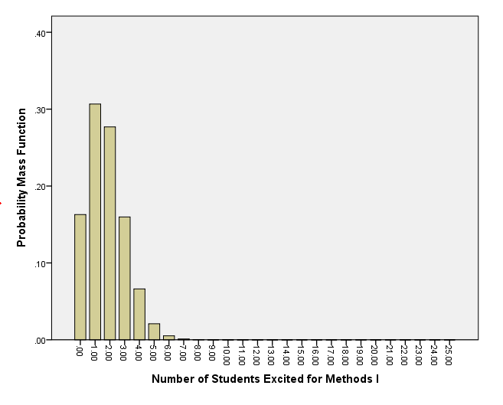

Slide 5
Let’s get this out of the way

Slide 6
Office Hours
There are none
We are here to help and will assist you as best we can should you exhaust your patience with Google and your classmates
Email us first with a specific question from the HW and a description about what is confusing you about it
Should we not be able to adequately help you via email or in class, request a 10-15 minute meeting
Showing up unannounced will likely be a fruitless endeavor
If we haven’t responded to your email sent before 8AM, after 4:30PM, or on the weekend, it’s because it’s before 8AM, after 4:30PM, or the weekend
Trust that we will respond to you as soon as we can

Slide 7
Help us help you

Slide 8
Help us help you
We want you to leave this class with an ‘A’
We really, honestly, properly do
What is the best way to lock in an ‘A’?
Get all the answers correct
Remember – there’s a difference between ‘not technically wrong’ and ‘correct’
i.e.,
‘Events A and B are not mutually exclusive. That is, neither event precludes the other event from occurring.’
‘No.’

Slide 9
Help us help you
We want you to leave this class with an ‘A’
We really, honestly, properly do
What is the best way to lock in an ‘A’?
Restate the question in your response
Show your work
How can we give you partial credit if all that is written down is an incorrect answer?
We love giving partial credit as much as you like getting it.
Please give us reasons for handing it out.

Slide 10
Statistics in medical research?
Why…?

Slide 11
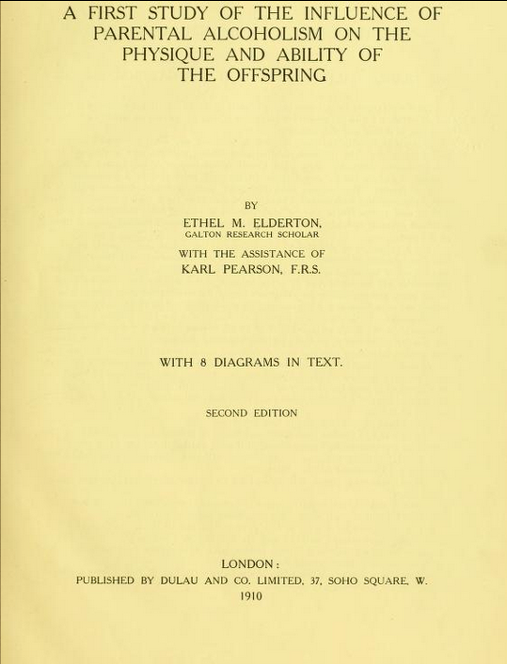
Why is statistics such a pervasive discipline in the conduct of medical research?
Why do we do medical research?
Is everything intuitive?
Why, if something is common sense, was there a study to verify the results?
More so, why would you be expected to show it now?

Slide 12
Why are you learning Biostatistics…?
Well…

Slide 13
Why are you learning biostatistics?
Because the first ‘MS’ in your MSMS degree stands for Masters of Science

Slide 14
Why are you learning biostatistics?
Because the first ‘MS’ in your MSMS degree stands for Masters of Science
Because biostatistics is on the United States Medical Licensing Examination
Because sometimes students/residents/fellows do research
MUSC Research Day
MUSC DoM Research Symposium
Most summer internships (at least at MUSC) have some element of research
Because sometimes consulting literature is necessary to determine best CoT
Staying up on recent research is important for every medical practitioner

Slide 15
Onto the good stuff…

Slide 16
Statistical Package for Social Science (SPSS)
SPSS performs statistical analysis with simple commands.
Does not require any coding.
Does require knowing when to use which statistical method.

Slide 17
SPSS Resources
H. Knapp, Introductory Statistics Using SPSS, 1st edition (2013)
UCLA
http://www.ats.ucla.edu/stat/spss/
There’s nothing you’ll be asked to do that a proper Google search can’t find instructions for

Slide 18
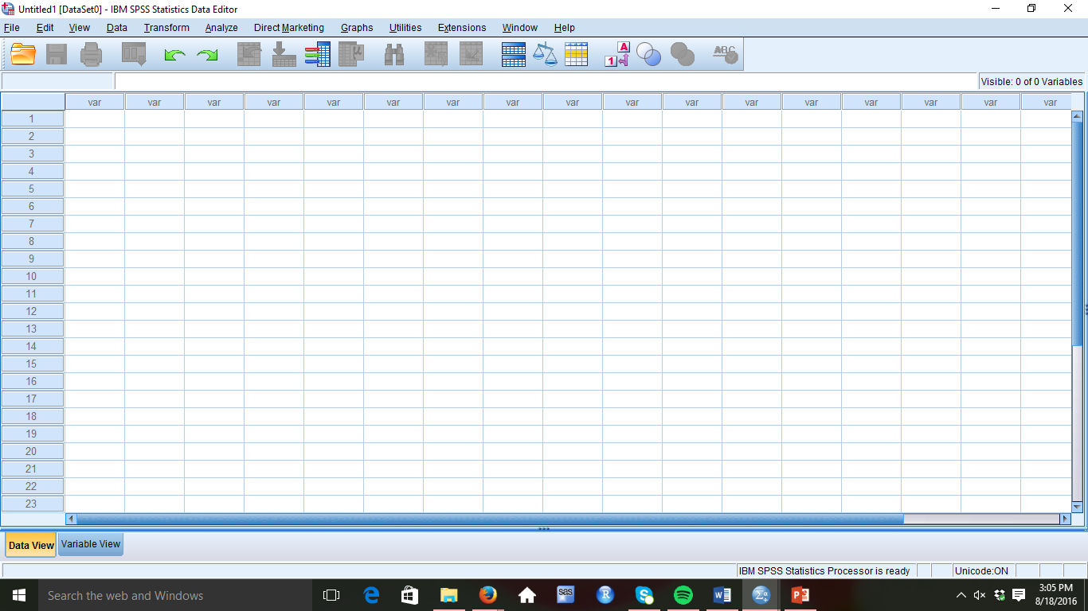
Data in SPSS
Under Data View:
You can manually input data
Visually inspect data

Slide 19
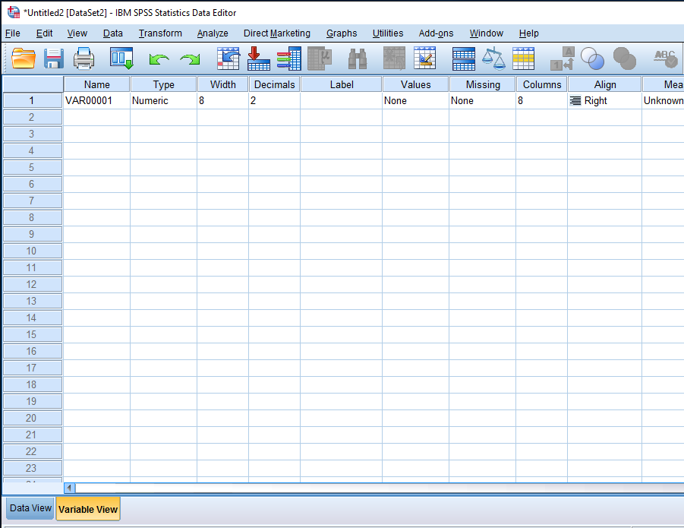
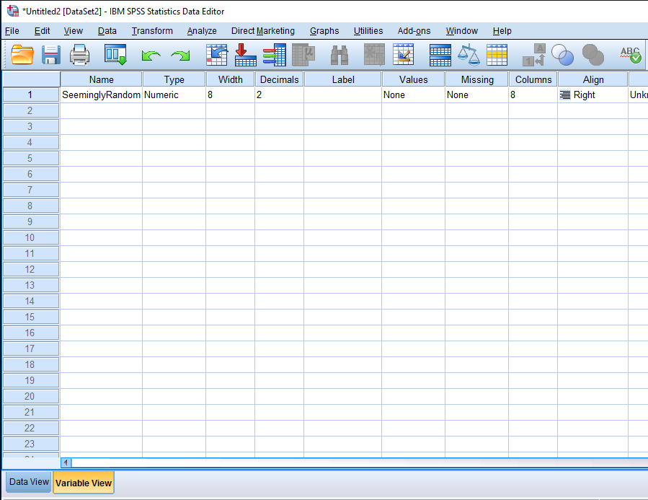
Data in SPSS
Yeah, yeah, yeah… It’s cool. We know.
You can name the variables
You can pick out the type of variable
You can nickname (label) the variables
Etc…
There are two tabs in the Data Editor: the Data View and the Variable View (shown)

Slide 20
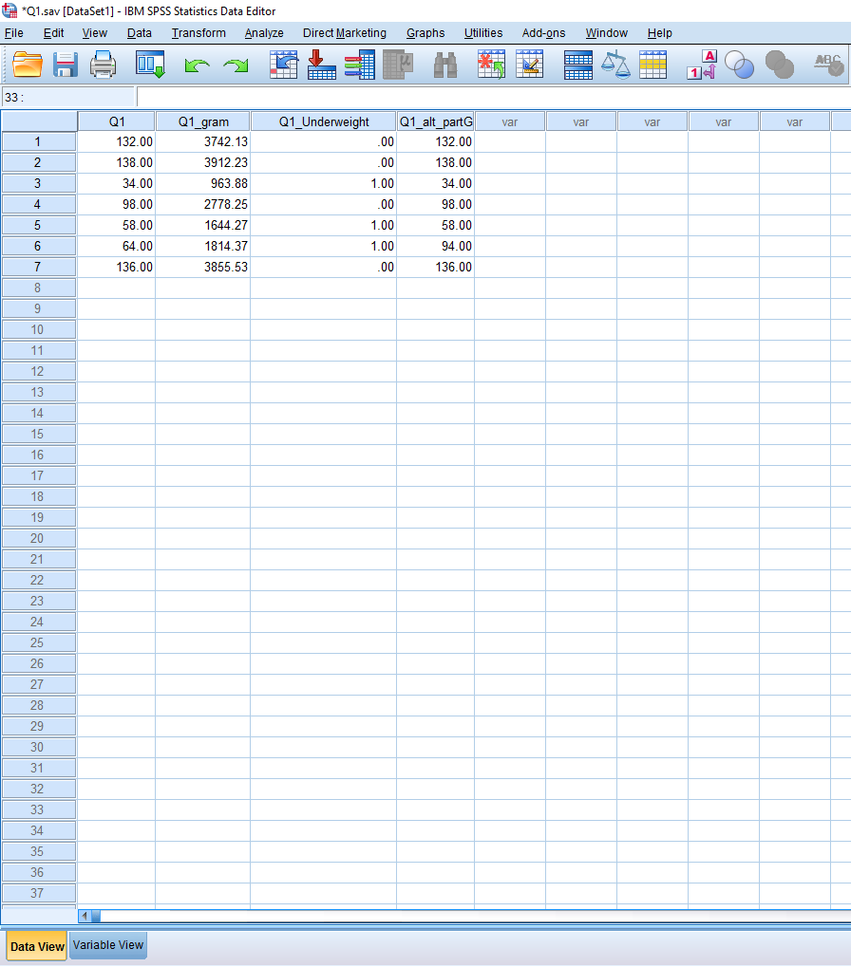
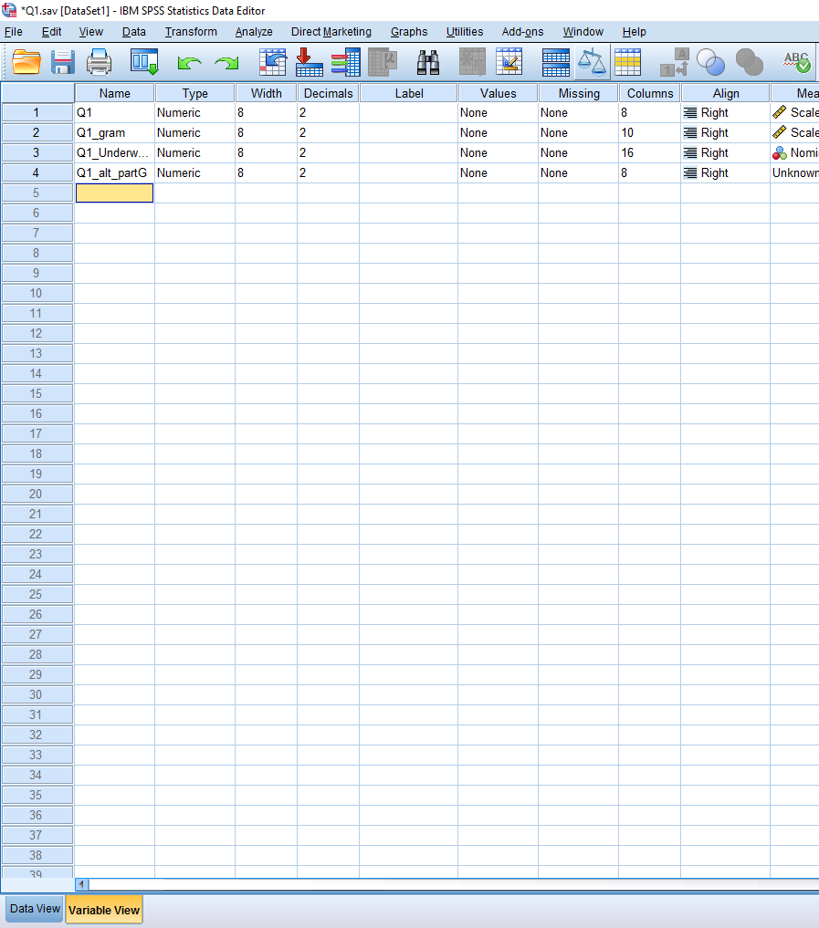
Data in SPSS
Data View
Variable View

Slide 21
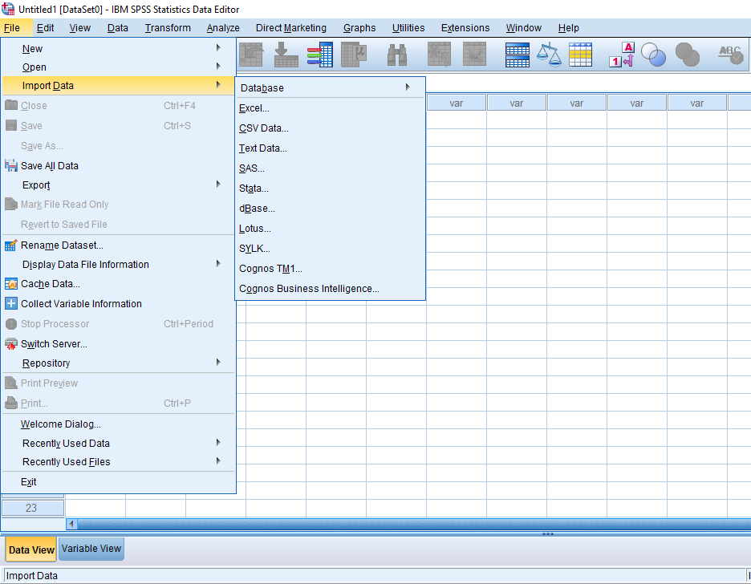
Data in SPSS
Getting data into SPSS can be performed two ways:
‘Import Data’ option
Manually entering data
SPSS can import most any data files
Excel
CSV
Text
SAS

Slide 22
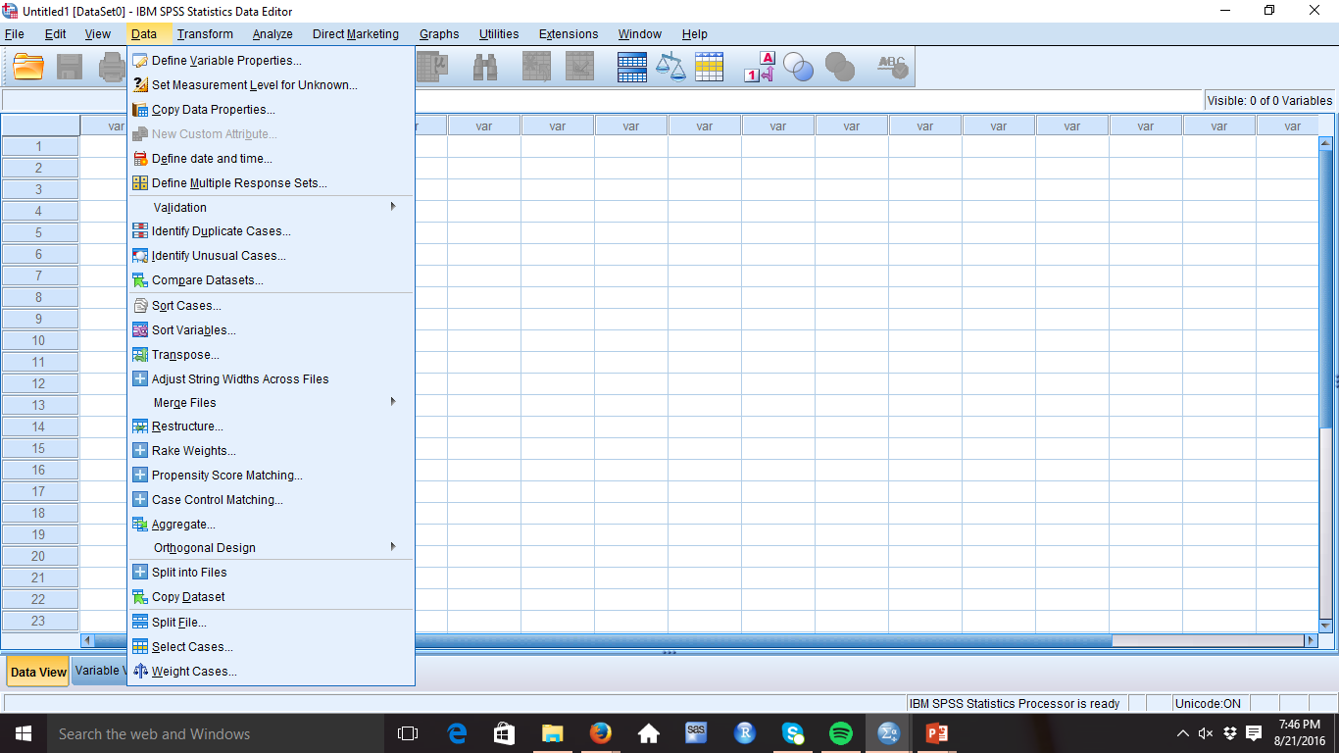
Data in SPSS
Data Management
Sorting Variables
Merging Files
Finding Duplicates
Creating Separate Files
Transposing
These options can be done under either of the views in the data editor

Slide 23
Data in SPSS
If you’re in a bind and having difficulties with importing data,
“ask not what your copy & paste can do for you, ask what you can do for your copy & paste”
So long as you’re careful, you should be able to copy & paste data if you’re having trouble getting data into SPSS
Always try to formally import data first
https://twitter.com/LauraBedrossian/status/755366624815902720

Slide 24
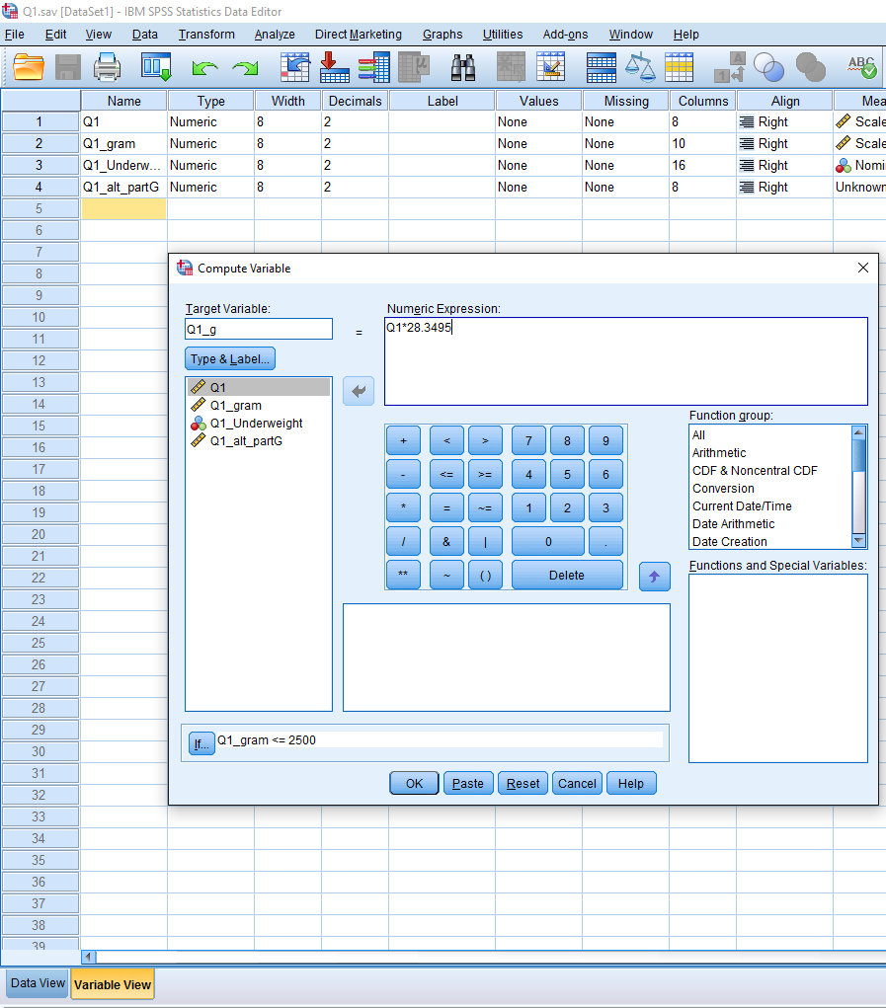
Data in SPSS
You can even Compute NEW variables!
We know what you’re thinking and yes, we’re serious
It IS that cool…

Slide 25
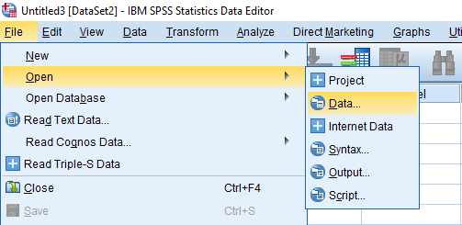
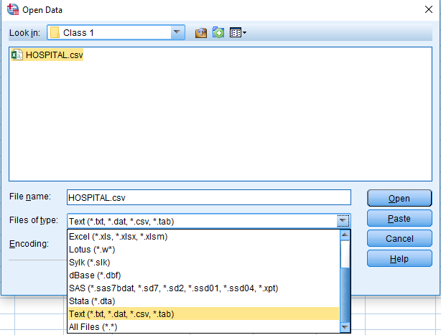
Data in SPSS: Importing
Go to Moodle HW and download all of the material for your HW assignment, to include ‘HOSPITAL.csv’
Once the CSV file is saved to your computer:
File
Open Data
Files of type: Text (.csv)
Select ‘HOSPITAL.csv’

Slide 26
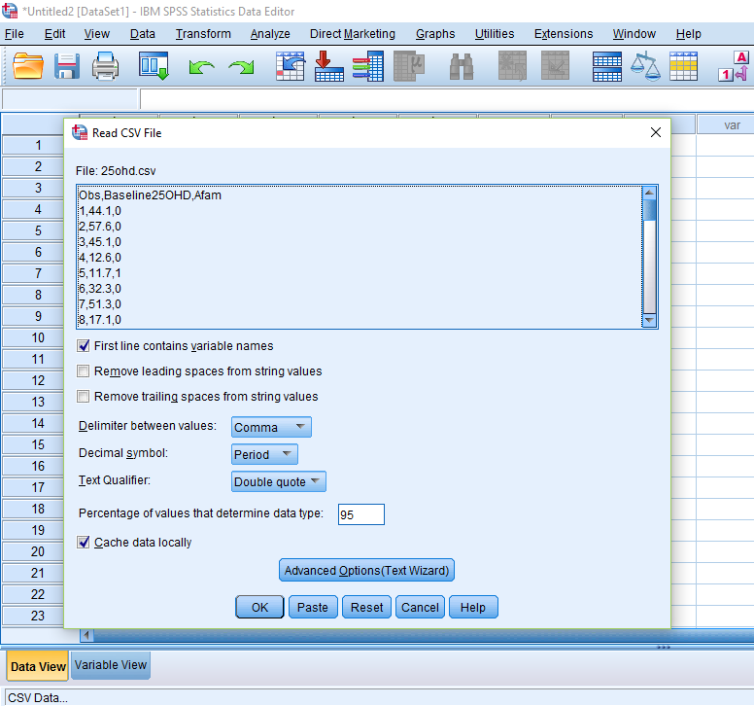
Data in SPSS: Importing
File
Open Data
Files of type: Text (.csv)
Select ‘HOSPITAL.csv’
Check “First line contains variable names”
OK

Slide 27
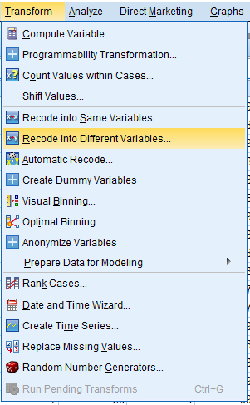
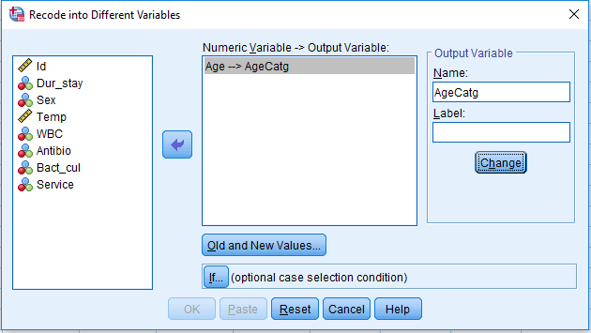
Data in SPSS: Computation
Compute a new variable based on Age
Transform
Recode into different variables…
Select -> Age
Output Variable: ‘AgeCatg’
Change

Slide 28
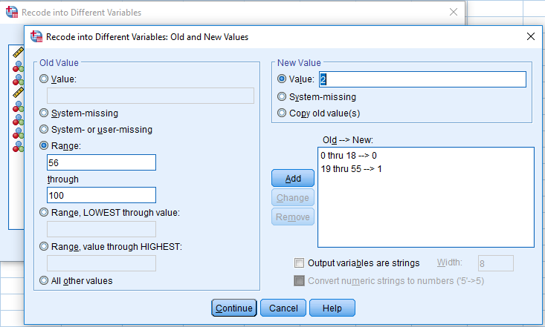
Data in SPSS: Computation
Transform
Recode into different variables…
Select -> Age
Output Variable: ‘AgeCatg’
Change
Old and new values…
Range
Use ‘0’ and ‘18’
New Value
Value: ‘0’
Repeat to make the categories 19-55 -> 1, 56-100 -> 2

Slide 29
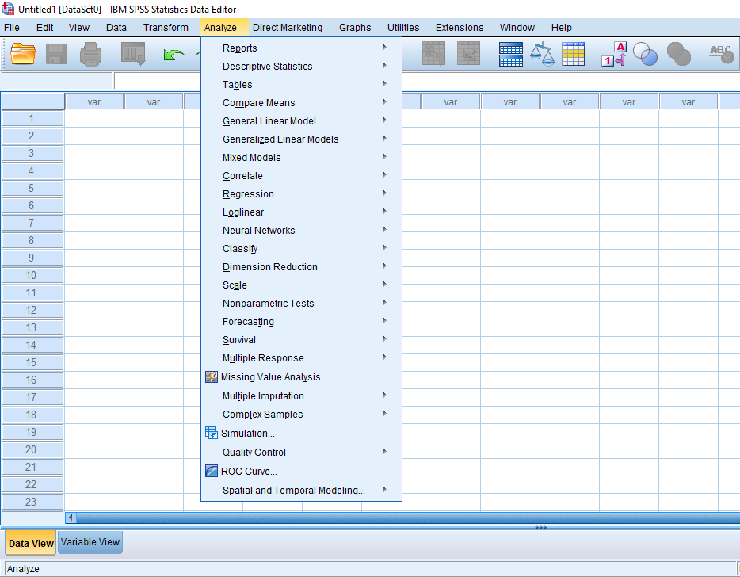
Analysis in SPSS
Visuals of the data are important first steps of any analysis
When there’s too much data to manually check everything, visuals can expedite the data QC process and lead to more informed decisions in an analysis
SPSS is capable of doing every analysis you’ll learn in this class

Slide 30
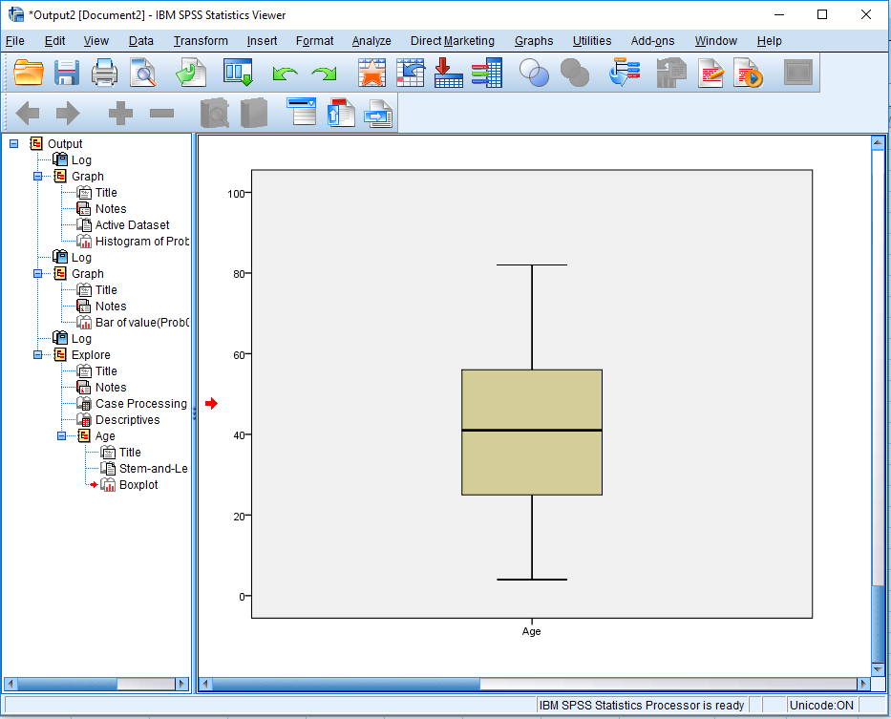
Analysis in SPSS - Exercise
Compute a graphical display of the data
Analyze
Descriptive Statistics
Explore
Select: Age
Display : ‘Both’
Statistics : ‘Descriptives’

Slide 31
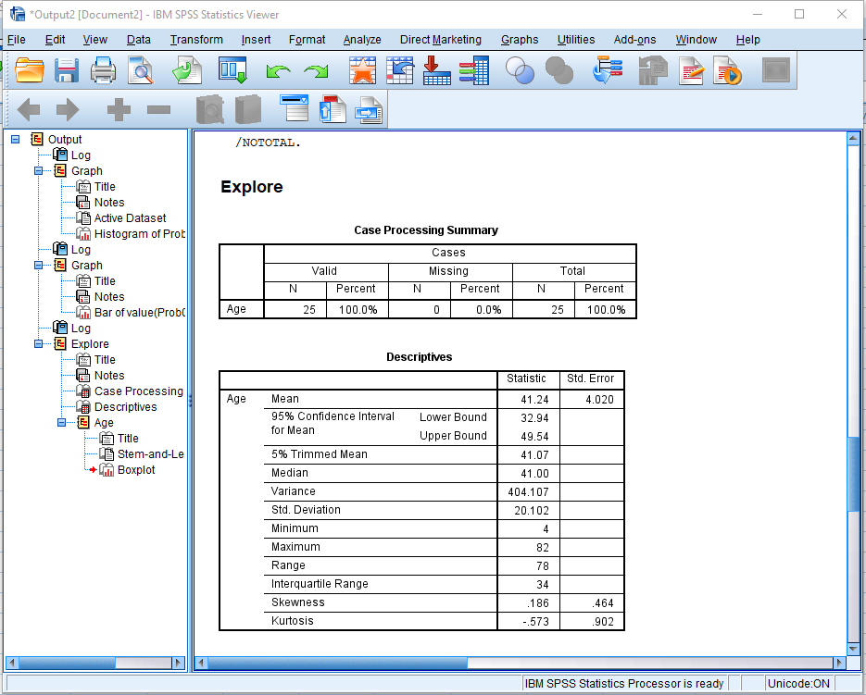
Analysis in SPSS - Exercise
Check the results of the previous step
Check the descriptive statistics and the plot

Slide 32
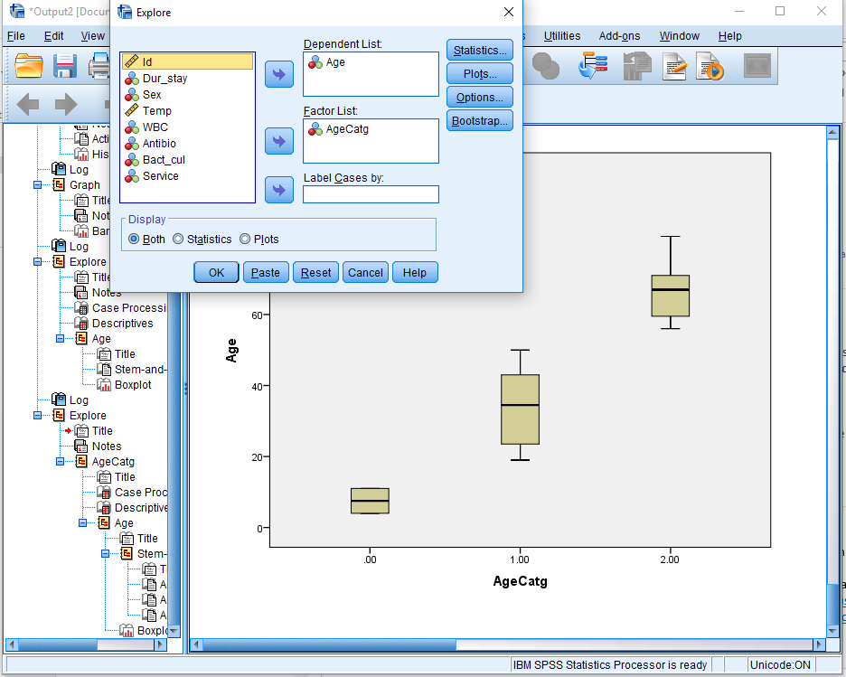
Analysis in SPSS - Exercise
Compute a box plot of the data that shows separate the values for different groups previously generated
Analyze
Descriptive Statistics
Explore
Select: Age
Display : ‘Both’
Statistics : ‘Descriptives’
Factor List:
Select: AgeCatg

